Slide 1

EXPLORING
EMOTIONS
“ Our full range of emotions is our palette with which we bring color to our lives."
By Mohamed ahmed
Dr. Yasmeen abdelmohsen

Slide 2

InTRODUCTION
This dataset contains short text samples (likely from personal posts, journal entries, or social media) labeled with emotional categories to represent the primary emotion expressed in each sentence. Each entry consists of a text field describing a personal feeling or experience, and a corresponding label field indicating the dominant emotion.

Slide 3
InTRODUCTION
The emotions are categorized into six classes :
0 : Sadness
1 : Joy
2 : Love
3 : Anger
4 : Fear
5 : Surprise

Slide 4

“ We cannot selectively numb emotions; when we numb the painful emotions, we also numb the positive emotions. "
— Brené Brown

Slide 5

Let’s move forward to codes

Slide 6

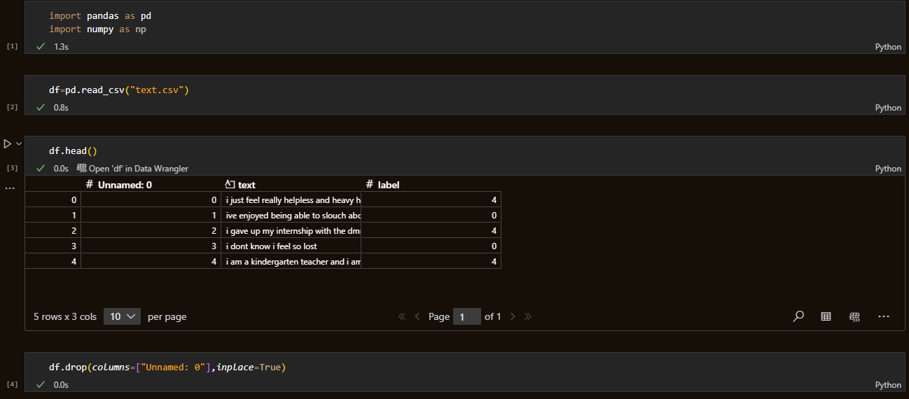
NLP
Display head of the data
Reading the dataset
Deleting the unnecessary column “unnamed”

Slide 7

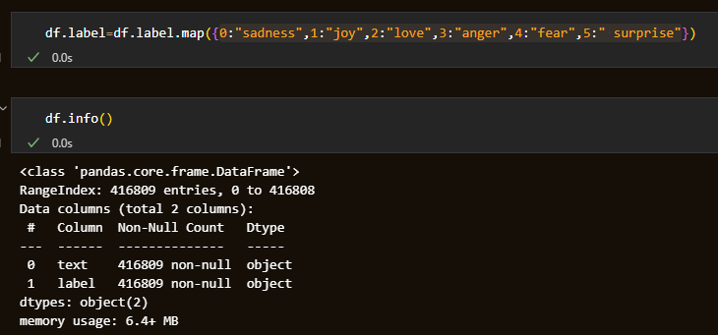
NLP
jf
converts numerical emotion labels into readable text labels .
Ensures the data doesn’t have null values .

Slide 8
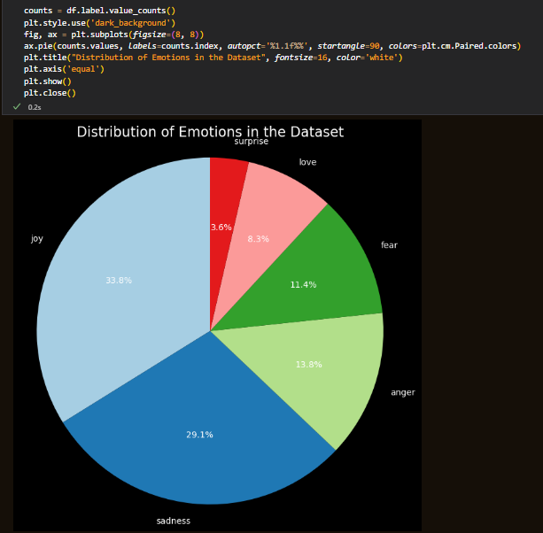
NLP
Pie chart for emotions distribution

Slide 9
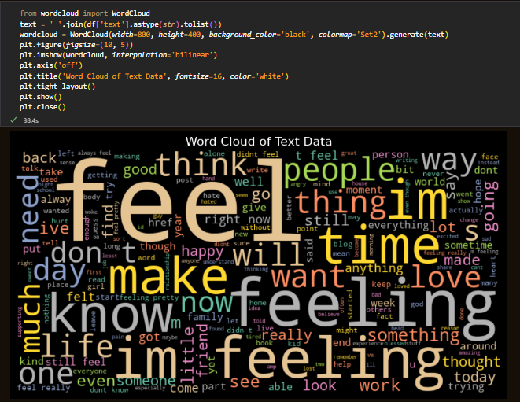
NLP
Word cloud for text distribution

Slide 10
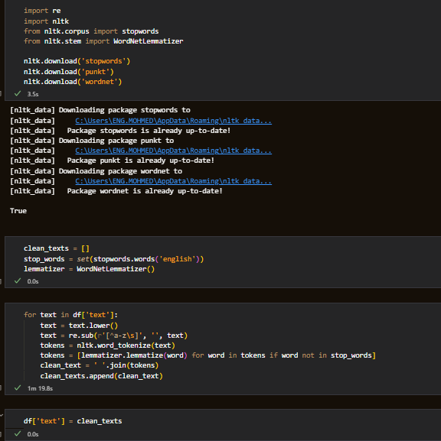
NLP
Text preprocessing consists of :
Lower case
Tokenization
Lemmatization
Stop words removal

Slide 11
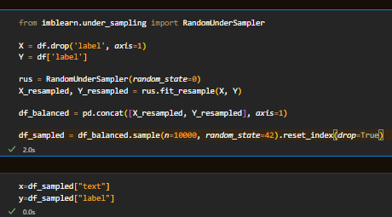
NLP
balances the dataset by undersampling the majority emotion classes using RandomUnderSampler, then randomly selects 10,000 samples to create a smaller, balanced subset for analysis or model training.
Defining the X and Y

Slide 12
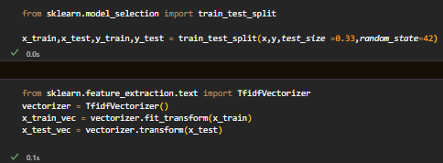
Splits the x and y into train and test datasets
Converts text data into numerical feature vectors using TF-IDF (Term Frequency–Inverse Document Frequency), allowing the model to understand and learn from the importance of words in the training and testing datasets.
NLP

Slide 13
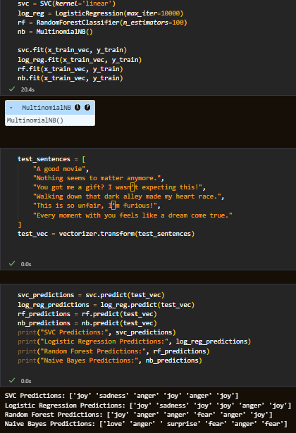
NLP
Training models :
Support vector classifier
Logistic regression
Random forest classifier
Multinomial naïve base
Make some predictions

Slide 14

“ The good life is not one immune to sadness but one in which suffering contributes to our development. "
— Alain de Botton

Slide 15
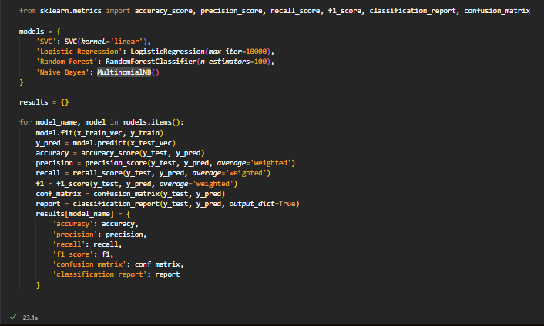
NLP
For loop to calculate all classification metrics for all models

Slide 16
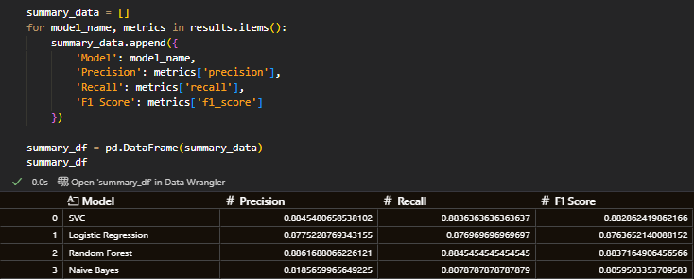
NLP
Data frame of the metrics of all models

Slide 17
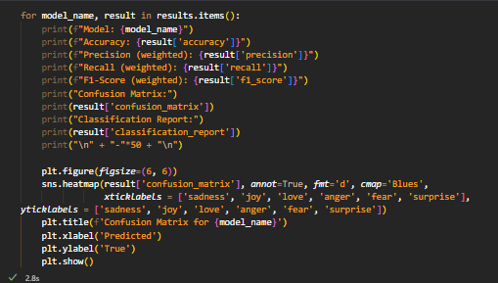
NLP
For loop to print all classification metrics for all models and plot the confusion matrix

Slide 18
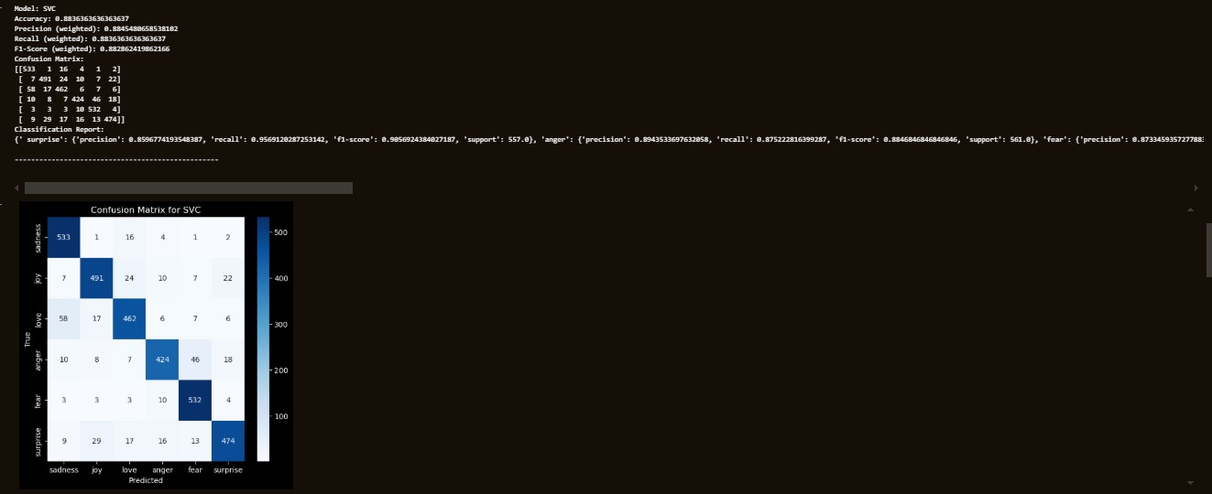
NLP
Support vector classifier (%88)

Slide 19

NLP
Random forest classifier (%87.9)

Slide 20
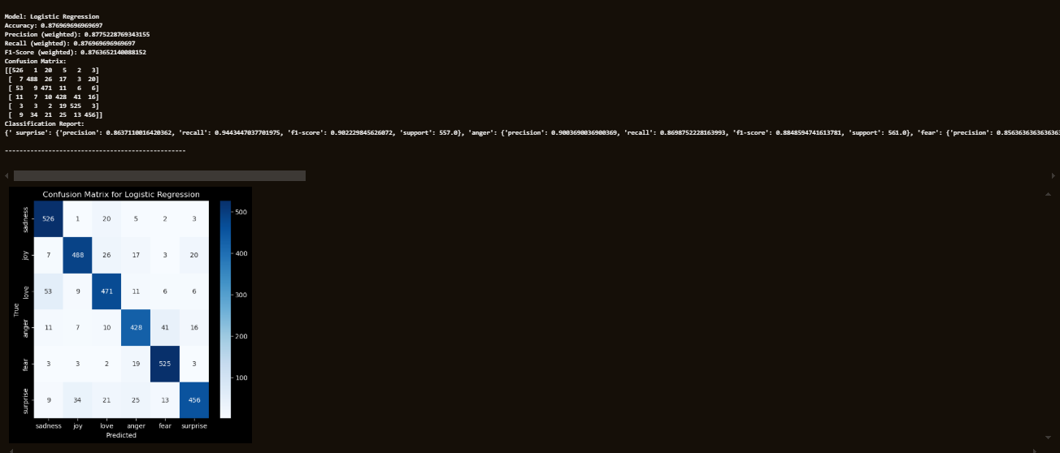
NLP
Logistic regression (%87.6)

Slide 21

NLP
Multinomial naïve base (%80)

Slide 22
ranking models
The best models based on classification metrics :
Support vector classifier (%88)
Random forest classifier (%87.9)
Logistic regression (%87.6)
Multinomial naïve base (%80)
Total running time = 3.40 minutes

Slide 23
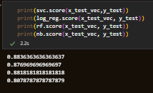
NLP
We measured the model's performance on the test data to check for overfitting. The test score is high and closely matches the training score, indicating that the model is generalizing well and is not overfitting.

Slide 24
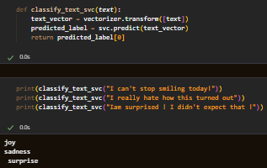
NLP
We used the best-performing model , SVC (Support Vector Classifier) , to build a function that predicts the emotions expressed in given sentences.

Slide 25
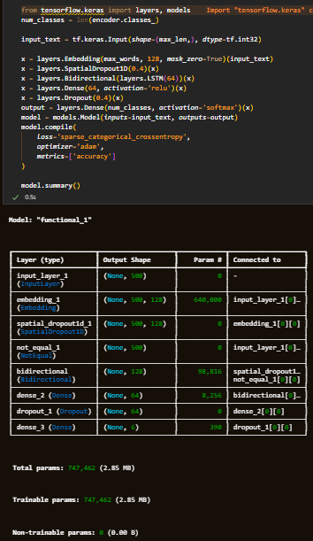
NLP
Using neural networks with the LSTM
Building & plotting the model and all layers

Slide 26
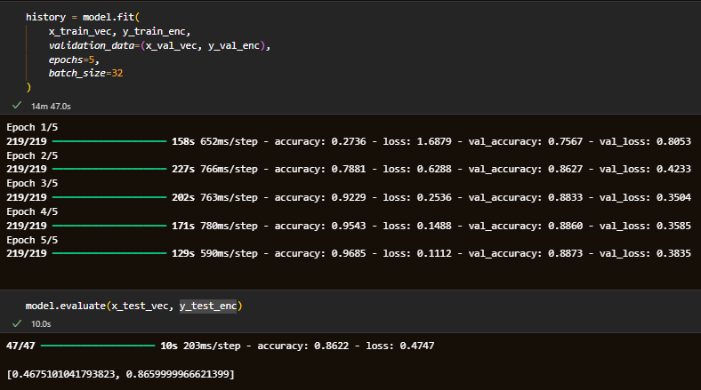
NLP
Using neural networks with the LSTM
Model training and evaluating

Slide 27

Thank you and
don’t forget
“ Emotions are not problems to be solved , but signals to be understood. "

